Slide 1
Improv Technology
OVERVIEW
2006

Slide 2
Technology Overview
Jazz PSATM Architecture
JazzTM Software Development
JazzTM Hardware Development
JazzTM Hardware Debug
Silicon Implementation
Additional Information:
Interrupt Support on the Jazz PSATM
NotationTM Programming Model

Slide 3
Jazz PSATM
ARCHITECTURE

Slide 4
Improv Jazz DSPTM Architecture
High Performance – single processor 1.5 BOPS @ 100 MHz
  VLIW and multiprocessing allow you to scale performance
  2-stage pipeline ensures efficient handling of control code and branches
  Typical processor configuration enables 7 data (32- or 16- bit) memory accesses per clock cycle and 16 register accesses
Low Power – < 0.1mW/MHz in 0.13um technology
  Multiple operations per instruction means lower clock speeds for your system
  Power management modes give you control over consumption
Rapid Development – application to RTL flow in 1 day
  High level language, structured development methodology
  Less than 1 hour to create a designer-defined DSP
  Integrated verification support for function, instruction-level, cycle-level, RTL, FPGA emulation and HW debug

Slide 5
Technology & Architecture
Jazz DSPTM
  State-of-the-art VLIW processor architecture
  Fully configurable including the addition of designer-defined logic
Multiprocessor Core Structure
  Multiple, heterogeneous processors in a single core
  High-speed, direct connection between processors avoiding traditional bus-based communications
System-on-Chip Integration
  Seamless connection to ARM and MIPS based systems
  Integration peripherals and application-specific interfaces
  Foundry independent and synthesizable using standard design flows
Robust Tool Support
  Application development, compilation, profiling and analysis
  Graphical creation of designer-defined DSPs

Slide 6
Jazz DSPTM Features
VLIW Processor Architecture
  Parallel resource execution
  Different processor configurations achieve 1-16 operations per instruction
  VLIW Instruction Overlays give designers control over balance between parallelism and instruction width
Multi-Processor Structure & 2 Stage Pipeline
  Zero Glue via Q-Bus interface
Available in 32 and 16 bit data path versions
Interrupt Task queue allowing exception based calls
Instruction compression
  Innovative technique yields significant (>70%) savings for non-loop code
Low Power support
  IDLE Mode (Static State Held)
  SLEEP Mode (Glitch Free 98% clock shut down)
DSP conscious Addressing Modes
  Index
  Bit-Reversed
  Circular Buffer

Slide 7
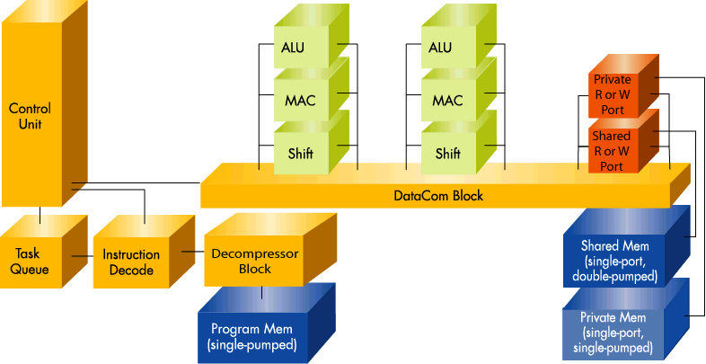
Jazz DSPTM Basic Processor Overview
VLIW with low number of pipe stages
  CU or MIU is controlled by Instructions slot
  All scheduling in the instruction is static
Load / Store architecture
Data and program address space
  Multiple / independent data
  address spaces
  Support for Addressing mode and
  Hardware loops
Distributed registers
  Each unit is ‘terminated’ by one or
  more (power of two) registers
HW interrupts & HW debug
Instruction compression
The Jazz DSPTM Processor ranges
from 50 – 200K gates:
  Utilizes about 1 sq. mm of die in base configuration
  Utilizes less than 0.1 mW/MHz in 0.13um @1.2v (TSMC)
  Delivered in Verilog RTL, with scripts, vectors and documentation
  Requires no custom cells for physical design

Slide 8
Configuration Options – Jazz DSPTM Processors
Select the type and number of operations in a cycle – variable number of slots in the VLIW instruction
Select the type and bandwidth of memory accesses per cycle
32-bit or 16-bit data path
Select variable number of constant registers
Select a variable number of registers and location of registers
Option to incorporate instruction compression
Overlap Computational Units (CUs) in any CU slot, and Memory Interface Units (MIUs) in any MIU slot. Increase resources without increased instructions size.
Insert custom- designer defined computational units (DDCU) for acceleration or for power saving
Multi-cycle and Pipeline CUs
Configure interrupt capability at two levels
Configure Hardware debug capability
Configure complex addressing modes (index, bit-reversal, etc) and address registers in address units
Configure data movement organization

Slide 9
Jazz DSPTM 2020 - Dual MAC Processor
Total Instruction Width = 151 bits
Base (w/Immediate)
(32b)
OutSel
(20b)
CU Slot 0
(29b)
CU Slot 1
(29b)
MIU Slot
(41b)
Total Gate Count (w/o Memories) = 105K gates
(TSMC 0.13 um)
Medium Application Range DSP for VoIP, Encryption, Edge Networking, 3G Wireless

Slide 10
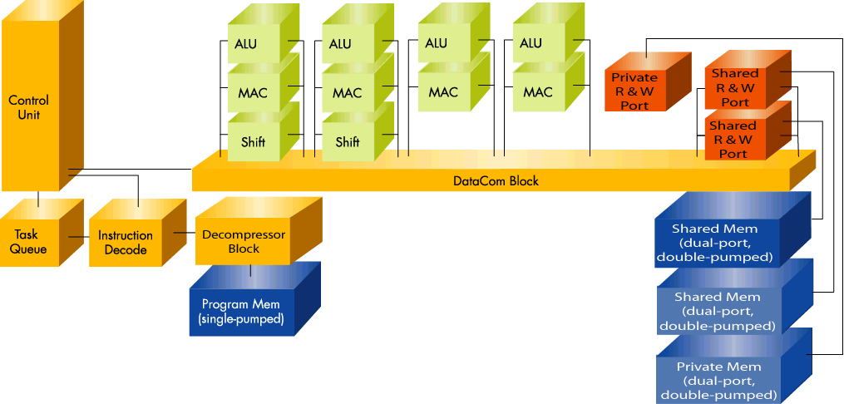
Jazz DSPTM 2040 - Quad MAC Processor
Total Instruction Width = 251 bits
Base (w/immediate)
(32b)
OutSel
(33b)
CU Slot 0
(31b)
CU Slot 1
(31b)
CU Slot 1
(21b)
CU Slot 1
(21b)
MIU Slot
(40b)
MIU Slot
(42b)
Total Gate Count (w/o Memories) = 155K gates (TSMC 0.13um)
High end processor configured for performance intensive applications

Slide 11
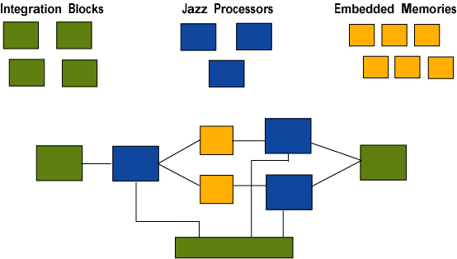
Programmable Systems Architecture (Jazz PSATM)
Multiple Jazz DSPTM Processors are configured into a structure that can be programmed to perform application-specific functions
Integration blocks (or I-Blocks) can be added to provide specific interface functions around the structure
Processor to processor data communication is handled through direct on-chip data memories
All processors are attached to a single Q-Bus that enables queuing of the tasks

Slide 12
Sample Jazz PSATM Platform
VoIP - Voice Processing System (VPS)
  Dual Processor core
  16-channel Back-Office CPE VPS (@100MHz)
Software
G.726 Codec, VAD, DTMF
Software
G.168 Echo
Cancellation
16K byte
Data
Memory
16K byte
Data
Memory
Host
Bus
Interface
Jazz
Voice
Processor
Jazz
Echo
Processor
Time
Slot
Interchange
16K byte
Shared
Mem
60k byte
Instruction
Memory
60k byte
Instruction
Memory

Slide 13
Custom SoC Platforms
Reference Jazz PSATM & ARM Platform
Interrupt
Controller
AHB
HBI
Jazz PSATM
Sub-System
USB
APB Bus
ARM9
AHB <-> APB
Bridge
Timers
FLASH &
EEPROM
Denali Databahn
High-Bandwidth
External Memory
Interface
AHB <-> ASB
Bridge
Ethernet
MAC
UART
SRAM
DRAM
DMA
Controller
LCD
Controller
1²C
AHB Bus
On-Chip
SRAM
ASB Bus
DMA
Controller
GPIO

Slide 14
Design
METHODOLOGY
Jazz Software Development

Slide 15
Application Development for Configurable Platforms
Application Design Spec
NOTATIONTM
Functional Coding/
Verification
Java / C Source
SOLO
Compilation/
Mapping
Hardware Resources
COMPOSERTM
Platform
Configuration
Insert
DDCU
Instruction cycles
memory usage
resource usage
No
Yes
NOTATIONTM
Performance
Analysis
Existing
Resources
Inadequate?
Software
optimization
Reconfigure
Platform
Performance/
memory usage
Competitive?
No
No
Yes
Go to ISS/Development Board/Release

Slide 16
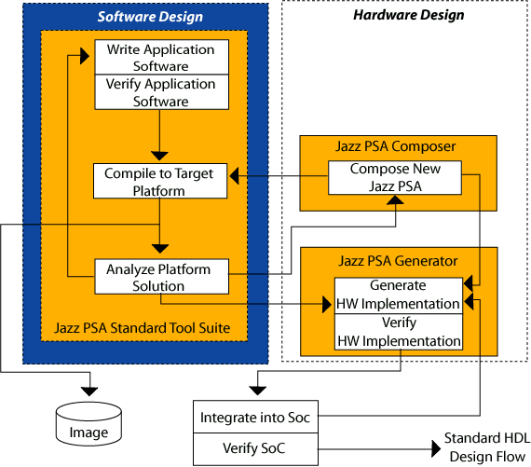
Concept to Silicon - Integrated Design Environment

Slide 17
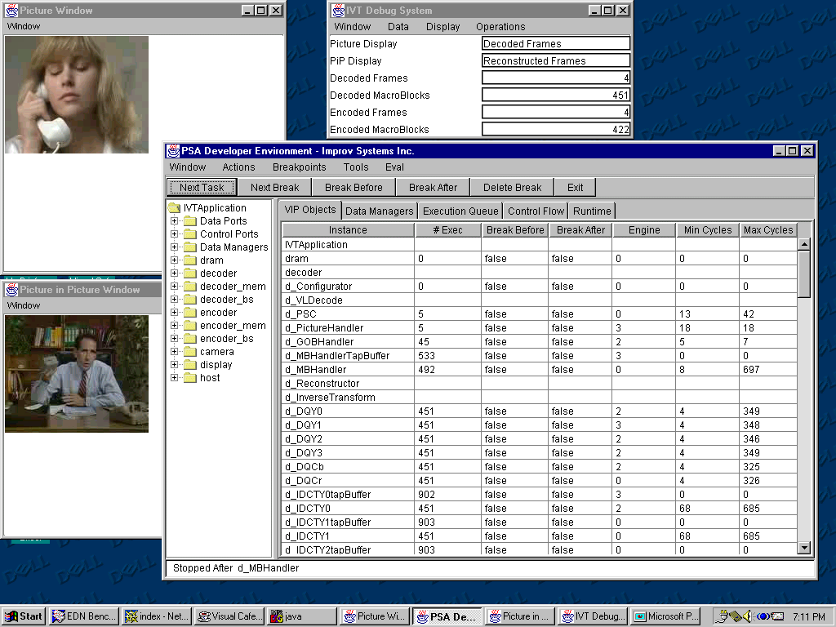
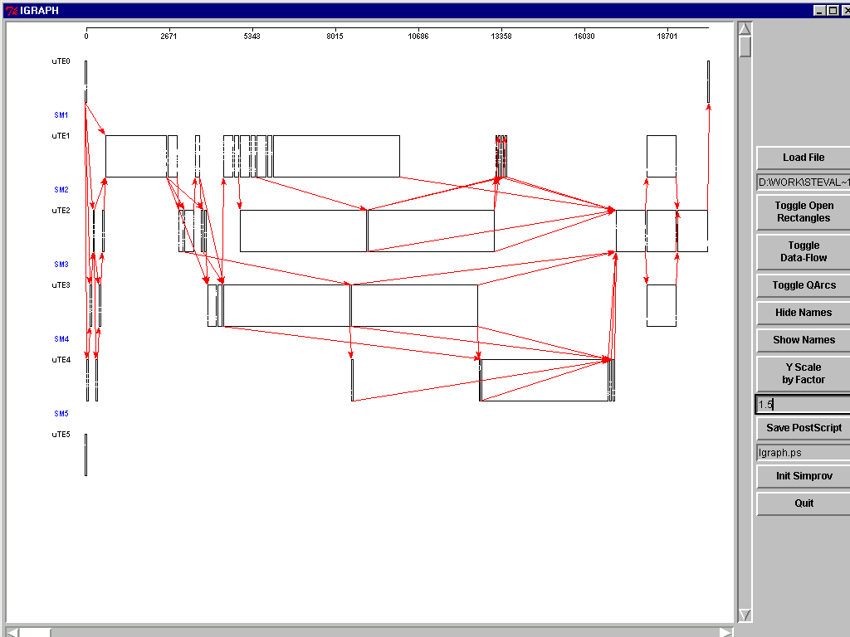
Jazz PSATM Tool Suite
NotationTM Environment
  Application development using Java
  Test bench development and virtual prototyping
  NotationTM debugger and application analyzer
Solo Compilation Environment
  Course-Grained Allocator – mapping of tasks onto multiprocessor structure
  Fine-Grained Allocator – micro scheduling and software pipelining to produce highly-packed VLIW instruction
  Back annotation and Analysis - advanced tools to analyze performance, utilization and optimization
Instruction-Set Simulator
  Cycle-accurate, multi-processor simulator executing compiled instructions
  High visibility and analysis of compiled instruction code

Slide 18
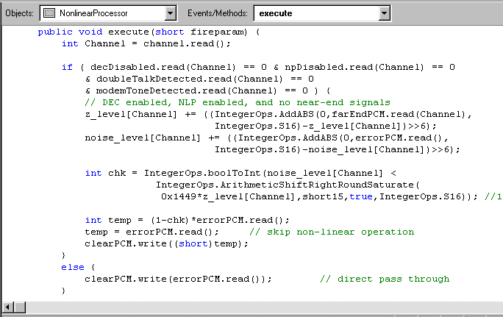
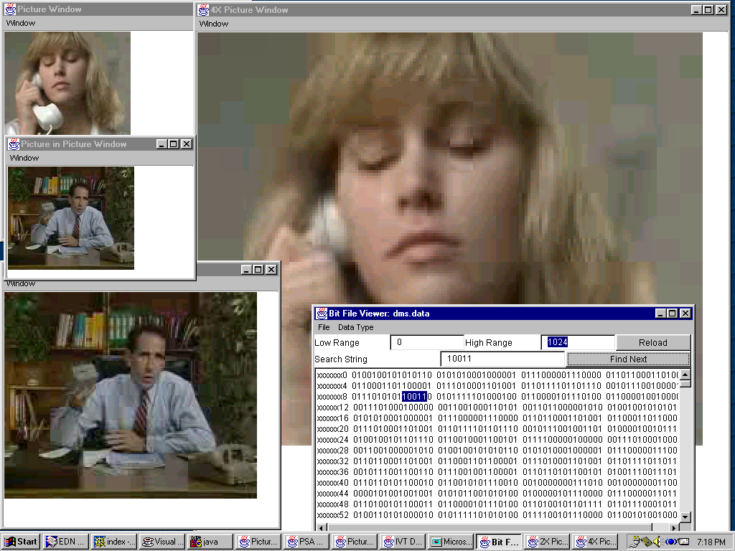
Software Development Tools
Application Development using wide range of Java supported IDEs from SUN, Web-Gain, Borland etc..
Integrated Test Bench Development and Virtual Prototyping utilizing Class Libraries
Notation Debugger and Application Analyzer utilizing cycle accurate simulator

Slide 19
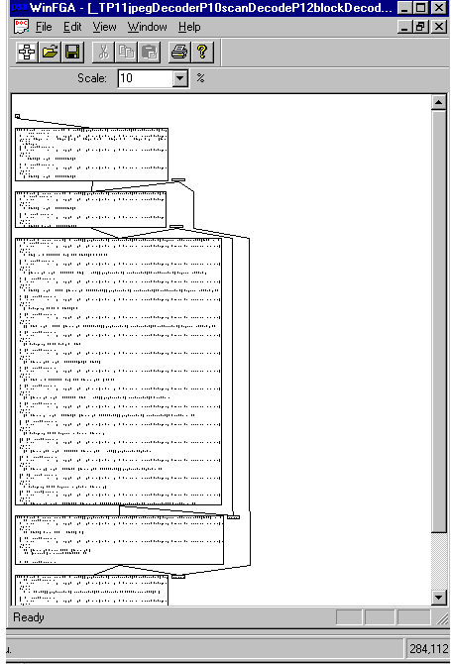
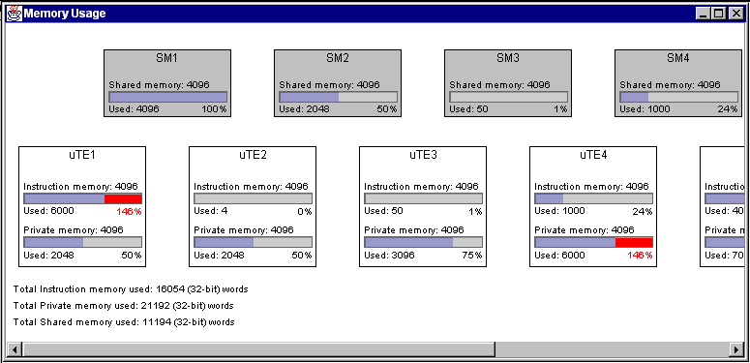
Compilation & Allocation
Coarse-Grained Allocation
Schedule-driven allocation and partitioning of tasks onto multiple processors
Profile-directed recompilation for added optimization
Fine-Grained Allocation
Advanced optimization and code generation
& State of the art resource-directed schedule techniques
Back Annotation and Analysis
Platform and Task Analyzers
Cycle Back Annotation

Slide 20
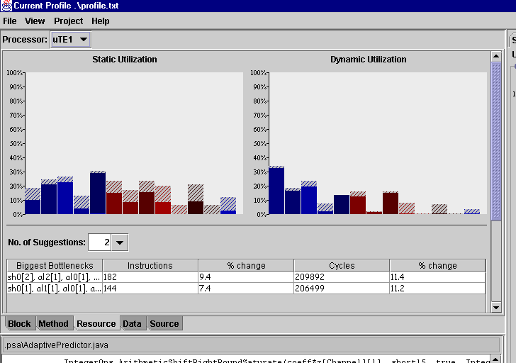
Feedback: Tuning Fork
Tuning Fork provides users with Dynamic and static Feedback:
Feedback is application and resource driven
Feedback is correlated to source code
Feedback includes recommendations

Slide 21
Debug Methodology
Functional Debug
  Functional Emulation in NotationTM
  Test coverage based on stimulus
Task-Level and Timing Debug
  Cycle-accurate instruction-set simulator
  Step by step debug of instructions and registers
  Everything you need for instruction tracing, code validation and optimization
RTL Debug
  Automatic generation of test bench comparing RTL simulation to emulation code
System integration and verification
  Encapsulated ISS (with PLI timing wrappers)
  Jazz PSA RehearsalTM development board for near real-time analysis
In-System Debug through HW Debug Support

Slide 22
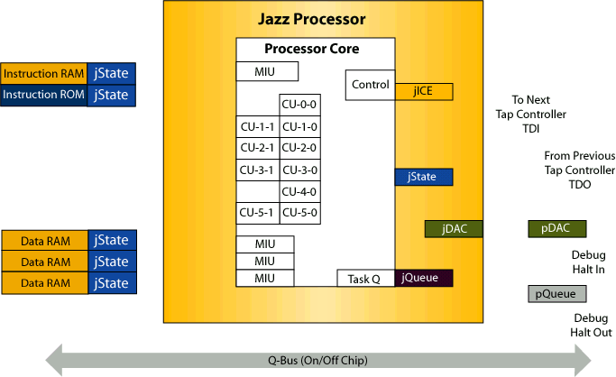
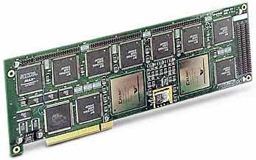
Robust Debug Through a Common User Interface
Host Desktop
User Debug
Environment
Debug
Manager
Functional
Simulator
Instruction Set
Simulator
Complete Debugging
Resources using a standard host Desktop PC
Drivers
PCI
Parallel
FS2
Debug
Interface Box

Slide 23
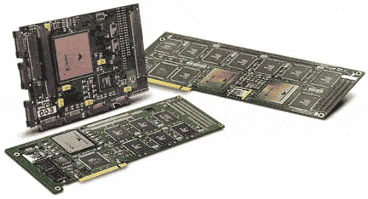
Jazz PSA RehearsalTM Development Boards
Processor and System Verification
  Map “Composed” Jazz DSPTM processors onto FPGA Technology, execute and test application code
  Use same test bench for functional, ISS and Jazz PSA RehearsalTM board simulation
  Windows NT drivers, PCI-based card
PCI Development Board Configuration
  Jazz PSA RehearsalTM XE-2 / 6K
  Dual FPGA (2-4 processor) configuration
  Development Board

Slide 24
Design
METHODOLOGY
Jazz Hardware Development

Slide 25
Why A Custom Application Engine?
You configure a Jazz DSPTM processor to meet performance, power, cost or time-to-market objectives
If pre-configured Jazz DSPTM processors meet your objectives, then configuration isn’t necessary
  Single, Dual, and Quad MAC Jazz DSPTM configurations available as standards
Customize to address specific application needs:
  For Performance; add accelerators, execution units or processors for critical application functions
  For Die size (cost) or power considerations; “de-configure” with just the resources needed
  For Time to Market; Select a pre-configured DSP, which acts like an off the shelf DSP to develop application and retain option to configure if needed

Slide 26
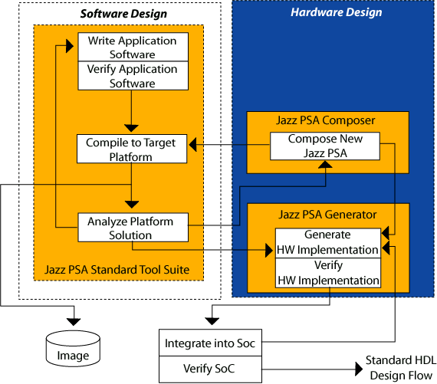
Hardware Design Flow

Slide 27
‘Composer’ Hierarchical Configuration
SOC
Platform
SoC
Composer
SoC
Configuration
File
SoC
Generator
PSA® Core Structure (including optional multiprocessor)
PSA
Composer
PSA
Configuration
File
Jazz PSATM
Generator
Standard
HDL Design
Flow
Jazz
Composer
Jazz
Configuration
Files
Improv
RTL
Jazz DSP™ Cores
Designer-Defined Computation Units
DDCU
Composer
DDCU
Configuration
File
Designer
RTL

Slide 28
Shortening the Design Cycle
Custom Logic
System
Design
RTL
Development
RTL
Optimization
4-8 weeks
12-20 weeks
4-8 weeks
20-36 weeks
Embedded
DSP
Application (SW)
Development
SW
Opt.
Assm.
Dev.
4 weeks
2 weeks
6 weeks
12 weeks
Custom DSP Analysis, Selection,
And RTL Gen.
Jazz PSATM
Platform
Application (SW)
Development
SW
Opt.
4 weeks
2
weeks
1
week
7 weeks

Slide 29
Creating Designer Defined Computational Units (DDCUs)
“Software Development”
“Hardware Development”
1) Define operations and associated state in Operations Class
2) Define DDCU with specific set of OpCodes
Operations
Class
User-defined operations and state
JazzPP
Template
Verilog RTL with macro generator support
DDCU
Composer
Used in C & Java application code
3) Map operations to OpCodes in DDCU Composer
Jazz PSA Tool Suite
(including Compiler)
DDCU
Configuration
File

Slide 30
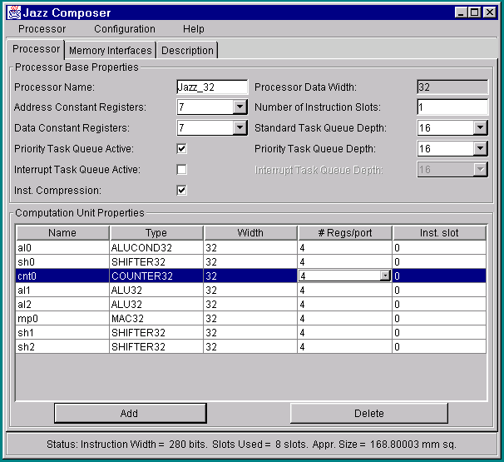
Jazz PSATM Composer
Innovative tool for creating custom processors and platforms using a simple methodology
Hierarchical Configuration – platforms, processors, designer-defined computation units
Platforms and processors can be completely configured using the graphical ‘drag-and-drop’ environment
Decoupling of software and hardware descriptions of custom units
  Java methods for use in application software
  Verilog (w/preprocessor) for hardware description

Slide 31
Overlaying CUs and MIUs
Datacom Example
MIU or CU
Slot (X-1)
Slot 1
Slot 2
Slot n
Slot n+1
Instruction
Width
CU-1-0
CU-2-0
MIU-n-0
MIU-n+1-0
Reminder:
Only one
CU/MIU per
slot active
in each
cycle...
CU-1-1
CU-2-1
MIU-n-1
MIU-1-0
MIU-2-0
CU-n-0
Overlap
Depth
CU-1-2

Slide 32
Core Units
The Core Units are the baseline building blocks of all Jazz PSA ComposerTM configured processors.
  Controller Unit
    Repeat Counter Unit
    Branch Unit
    Condition Unit
    Constant Register Unit
    Counter Unit
    Program Register Unit
  Task Queue Unit
  Datacom Unit
  Clock Control Unit
Core Units are configurable on an individual, but limited basis

Slide 33
Memory Interface Unit (MIU) Types
A wide variety of MIU types are available for use with the Jazz DSPTM Processor:
  Single Pumped - provide one READ or WRITE operation per cycle
  Double Pumped - provide two operations per cycle:
    Sequential READ/WRITE
  Arbitration MIU: multiple MIU to single memory
  DSP addressing modes
MIUs can include wait state support via a user selectable READY signal
MIUs can include bus arbitration support via user selectable REQUEST/ GRANT/ ACKNOWLEDGE signals

Slide 34
Jazz PSATM Configuration
Jazz DSPTM Processors
The designer creates a PSA Platform by utilizing the Jazz PSA ComposerTM Tool to map these three basic elements into an interconnection structure
Embedded Memories
Integration Blocks
Jazz PSA®
Composer

Slide 35
Example - Jazz PSATM Structures
Jazz DSPTM
Processor
Mem
iBlock
Jazz DSPTM
Processor
iBlock
Example PSA
Multiprocessor Structure #1
Mem
Jazz DSPTM
Processor
Q-Bus
Jazz DSPTM
Processor
Jazz DSPTM
Processor
Mem
iBlock
iBlock
Example PSA
Multiprocessor Structure #2
Jazz DSPTM
Processor
Mem
Jazz DSPTM
Processor
Q-Bus
Mem
Mem
iBlock
iBlock
Example PSA
Multiprocessor Structure #3
Jazz DSPTM
Processor
Jazz DSPTM
Processor
Jazz DSPTM
Processor
Q-Bus

Slide 36
Task Queue
Three individual task queues are available and configurable to the user:
  Standard Task Queue (default)
    This is the basic queue that follows our semantic model
  Priority Task Queue (optional)
    This queue allows a posted task to have priority execution over tasks on the standard queue (not preemptive – just order of execution)
  Interrupt Task Queue (optional)
    This queue allows an interrupt service task to preempt a currently executing task

Slide 37
iBlocks - Jazz Host Bus Interface (JazzHBITM)
Control
Interface
Control
Bus
For communication with the companion host processor, the Jazz PSATM utilizes the JazzHBITM as a shared resource between the host and Jazz PSATM
The JazzHBITM also provides the necessary functions to handle interrupt and control handshaking between the two processor complexes.
Dual-Port
RAM
Communication
Buffer
Shared
Memory
Interface
Host Bus
Interrupt
Logic
Host -> Jazz
Interrupt
Logic
Host <- Jazz
&
Status Regs
Q Bus
Host
Interrupt
Controller

Slide 38
iBlocks - Jazz Time Slot Interface (JazzTSITM)
External
TDM Highway
Highway
Interface
#1
Time
Slot
Interchange
Mechanism
The JazzTSITM allows the user to select multiple 64 kbit/s time slot channels for up to 4 highway interfaces and will provide basic time slot interchange capability as necessary for processing multiple voice channels.
External
TDM Highway
Highway
Interface
#2
External
TDM Highway
Highway
Interface
#3
µ or A Law
to linear
conversion,
Test Pattern
Generation
External
TDM Highway
Advanced
Highway
Interface
#1
External
Reference
Clock
Gen &
Control
Control Bus
Voice
Data
Buffer
Controller
Voice Data Bus
Q BUs

Slide 39
iBlocks - Bus Interface Units (BIU)
Bus interface units are used to allow direct connection of a Jazz MIU to an Internal (IBIU) or External (EBIU) system bus
  These units provide support for:
    Handling the specific protocol required to access the target bus
    Provide configuration registers to control address decoding and wait state generation
    Burst control
  In addition, the EBIU also provides support for access to:
    DRAM, SDRAM including access and refresh control
    Serial FLASH
BIUs are basically collars that bolt directly to an MIU

Slide 40
Jazz & PSA Generator
JazzGen and PSAGen within the Jazz PSATM Platform provides a complete implementation tool supporting standard ASIC methodology
Full methodology support
  Generates netlist of pre-verified Verilog RTL
  Automatic synthesis script generation
  Automatic static timing analysis script generation
  Verification / Regression test suite generation
Verilog
RTL
Platform
Definition
Synthesis
Scripts
Jazz PSATM
Implementation
Guide
Pre-Verified
Verilog RTL
Jazz PSA
Generator
STA
Scripts
Verification
Suite

Slide 41
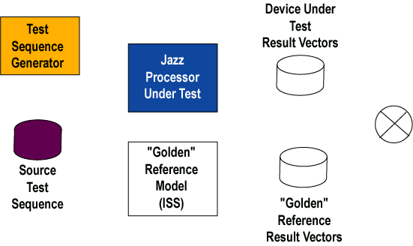

Verifying a “Composed” Processor
The “composed” Processor is compared against a “golden” Reference Model
  The Reference Model is an executing image of the cycle-accurate instruction set simulator
Users can also map their processor to an FPGA based Rehearsal card (using the Implementation Kit) and run application code on it

Slide 42
24 Hour Function to RTL Customer Example
9AM – Start with application software that is running and verified
9AM to 1PM – Analysis of application bottlenecks using profiling tools; experimentation with actively used utility functions
1PM to 3PM – Creation and analysis of different processor configurations
3PM to 5PM – Generation and simulation of RTL to verify operation of custom Computation Unit
Overnight – Design Compiler synthesis onto TSMC .18um library
Next day – Check synthesis results

Slide 43
Silicon
IMPLEMENTATION

Slide 44
HW Design Flow
Front End Design Tools
  Synopsys VCS for simulation & Verification
  Synopsys Cover Meter for evaluating code coverage
  Synopsys Design Compiler for Logic Synthesis
  Synopsys Test Compiler for Scan Insertion
  Synopsys PrimeTime for Timing Analysis
  Synopsys PrimePower for gate level power analysis
  Synopsys TetraMAX for test pattern generation

Slide 45
Physical Design
Jazz PSATM platforms have been implemented using the following back end flows
  Compass (5 engine PSA)
  Avant! (5 engine PSA)
  Cadence (6 engine PSA, 2 engine embedded PSA)
  Synopsys (6 engine PSA)
Timing Convergence
  Our preference is for a Timing Driven design flow with forward constraints provided from either:
    Design Compiler
    PrimeTime
    SDF generated by Design Compiler or PrimeTime

Slide 46
Design Flow Example
Block Logic Design Flow
Block Logic Implementation Flow
Block Specification
Initial Synthesis using
default wire models
(Synopsys Design Compiler)
Code RTL Modules
Early Netlist Release for
Floor planning
Trial Gate Netlist
Develop Verification
Modules
Synthesis & Optimization
using custom wire models
Custom Wire Models
RTL Verification
(Synopsys VCS)
DC or Primetime
Constraints, SDF
Netlist & Forward Timing
Constraints Release for
Detail Place & Route
Gate Netlist
“set load”, PDEF
Verified RTL Database
IPO using “set load” &
PDEF (as needed)
Gate Netlist
DC or Primetime
Constraints, SDF
Timing Driven
Design Flow
Netlist & Forward Timing
Constraints Release for
P&R ECO (as needed)
Gate Netlist
SDF, RSPF
Detail Timing Verification
with Back Annotated SDF
Gate Netlist
Gate Verification
(Synopsys VCS)
Verified Gate Database

Slide 47
Jazz PSATM Design Verification Methodology
Jazz PSATM blocks are typically verified using a 3 level verification strategy (depending on block complexity):
  (1) Sub-modules will be verified using directed test suites and random vector testing (where possible)
  (2) Modules verified using directed test suites and random vector testing
  (where possible)
  (3) Blocks verified with directed test suites and random vector testing
  (where possible)

Slide 48
SoC Design Verification Methodology
Within the SoC, the Jazz PSATM macro block will be verified using a 3 level verification strategy:
  (1) Integrate Jazz PSATM with BFM based Host Processor Model and verify bus interconnect using Host BFM and Jazz diagnostic programs
  (2) Integrate Jazz PSATM with full Host Processor Model and verify system interconnect using Host and Jazz diagnostic programs
  (3) Boot Jazz PSATM Application code and verify PSA functionality
Verification suites are developed as pass / fail tests for simple post-processing during regression runs
Make-files are used to automate regression runs

Slide 49
Test Strategy
The Jazz PSA implementation kit can easily accommodate the test strategy of the selected implementation design flow
The kit, as delivered, supports Full Scan and ATPG for
all logic and user configurable BIST for all embedded memories
DFT strategies that can be easily integrated by the user
  Implemented Vendor or customer defined BIST for all RAM and ROM
  Pad level boundary scan
  Module level boundary scan

Slide 50
NotationTM
PROGRAMMING MODEL

Slide 51
Improv NotationTM – Programming Model
Structured model for describing applications
  Definition of ‘tasks’ that are then tied together structurally
  Execute-on-demand model (vs. suspend model) enables zero-overhead context switching and predictable application timing
  True system-level design paradigm
Object-Orientation means reusable software
  Rapid integration of high-level C code for algorithms
  No more rewriting in assembly language or HDL
  Structural description implemented in Java class hierarchy; behavioral code in Java or C

Slide 52
NotationTM Programming Model for Jazz PSATM
Software Benefits
  Modularize application into a collection of tasks
  Structural construction facilitates isolated changes and code re-use
  Ease of portability – bring in tasks in ‘C’ that can be tied into the overall software architecture
  Expose parallelism and control flow
Java Implementation
  Java as an object-oriented syntax – we don’t use the system/OS features of Java (e.g., garbage collection, task model, etc.)
  Provides access to robust IDEs, test bench components and platform portability

Slide 53
C Code Conversion
Java and C are identical for describing behavioral algorithms
Only conversions are:
  Pointer arithmetic and de-references
  Insert calls to ‘intrinsics’ for direct access to DSP capabilities (regardless of C or Java) or designer-defined computation units
Create ‘structural’ definition of your application
  Encapsulate tasks into Virtual-IP (VIP) classes
  Instance and ‘wire’ VIPs together
  Greater flexibility and code re-use

Slide 54
C Code
short *InputData, /* input data */
*AutoCorrData; /* output data */
void fxpAutoCorrelation (
short DataSize, /* size of input data */
short NumberOfLags, /* size of output data */
short Scale /* partial product scale (bits) */
)
{
int i, lag, LastIndex;
int Accumulator;
/* Compute AutoCorrelation */
for (lag = 0; lag < NumberOfLags; lag++) {
Accumulator = 0;
LastIndex = DataSize - lag;
for (i = 0; i < LastIndex; i++) {
Accumulator += (InputData[i] * InputData[i+lag]) >> Scale;
}
AutoCorrData[lag] = (short) (Accumulator >> 16) ;
}
}

Slide 55
Java Code (Method)
short InputData[], /* input data */
AutoCorrData[]; /* output data */
void fxpAutoCorrelation (
short DataSize, /* size of input data */
short NumberOfLags, /* size of output data */
short Scale /* partial product scale (bits) */
)
{
int i, lag, LastIndex;
int Accumulator;
/* Compute AutoCorrelation */
for (lag = 0; lag < NumberOfLags; lag++) {
Accumulator = 0;
LastIndex = DataSize - lag;
for (i = 0; i < LastIndex; i++) {
Accumulator += (InputData[i] * InputData[i+lag]) >> Scale;
}
AutoCorrData[lag] = (short) (Accumulator >> 16) ;
}
}

Slide 56
Java Code (Virtual IP)
public class fxpAutoCorrelation extends VirtualIP implements PSATask {
ShortPort InputData, AutoCorrData;
ShortDM DataSize, NumberOfLags, Scale;
PSAControlPort compute, completed;
public fxpAutoCorrelation() {
InputData = addShortPort("InputData", PSAMode.IN, dSize);
AutoCorrData = addShortPort("AutoCorrData", PSAMode.OUT, lags);
DataSize = createShortDM("DataSize");
NumberOfLags = createShortDM("NumberOfLags");
Scale = createShortDM("Scale");
compute = addControlPort("compute", PSAMode.IN);
completed = addControlPort("completed", PSAMode.OUT);
}
public void execute (short fireParam) {
int i, acc, LastIndex;
for (int lag=0; lag < NumberOfLags.read(); lag++) {
acc = 0;
LastIndex = DataSize.read() - lag;
for (i=0; i<LastIndex; i++) {
acc += (InputData.read(i) * InputData.read(i+lag)) >> Scale.read();
}
AutoCorrData.write(lag, (short)(acc >> 16));
}
completed.fire();
}
}

Slide 57
Interrupt Software Support
Interrupt handlers can be written as regular tasks using high level language
  No more detailed assembly programming or tedious ISR relocation and constraints
  Interrupt handlers can do anything a normal task does
  Same tasks can be activated through software or through interrupts
  Access to low level functionality through built-ins (intrinsics)
Compiler automatically analyzes interrupt handler and generates code to save and restore state
  Don’t pay the overhead of saving and restoring full state; only save what is absolutely needed

Slide 58
Hardware Interrupt Support
Advanced hardware support for interrupts
  Integrated into the host bus interface (HBI) block
  External, timer and internal (software generated) support
  Tied into the task queuing infrastructure giving maximum flexibility for interrupt handling
  System interrupts – reset, sleep, idle, …

Slide 59
Run-Time Handling
User-Defined Table
HBI
INT1
TASK1
INT2
TASK2
INT3
TASK3
INT4
TASK4
Q-BUS
Jazz DSPTM
Jazz DSPTM
Timers
TASK1
TASK2
TASK3
TASK4

Slide 60
Conclusions
Improv’s Configurable VLIW DSP processor architecture provides high performance processing engines and rapid design methodology to meet aggressive Time to Market requirements
Flexible – programmable architecture meet the needs of broad application support and firmware upgradeability
Complete Software Solution kits for vertical markets
Integration and implementation tools and methodology
Silicon implemented and customer proven technology

